Slide 1


DAYANANDA SAGAR UNIVERSITY
SCHOOL OF ENGINEERING
Department of Computer Science and Engineering
(Artificial Intelligence & Machine Learning)
INTERNSHIP REVIEW 1
SHIPPING ROUTE EFFICIENCY ANALYSIS FOR THE LOGISTICS SECTOR
Under the Supervision
Ms. Dhrishti Madaan
Dr. Joshuva Arockia Dhanraj
Presented By:
Rahul V(ENG22AM0189)

Slide 2
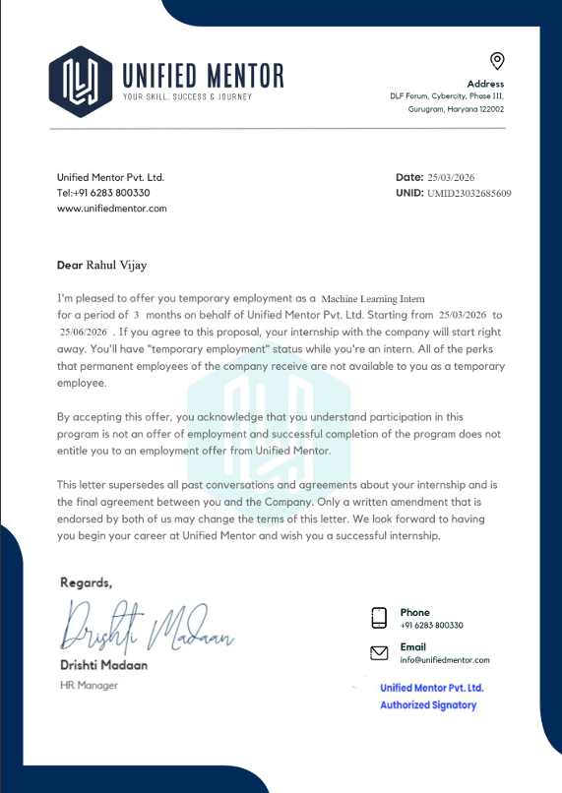

Slide 3

TABLE OF CONTENTS
01
04
02
05
03
06
Internship Overview
Methodology
Introduction
Experimentation
Problem Definition
Results
Dept of CSE (AI & ML), SOE-Dayananda Sagar University

Slide 4
INTERNSHIP OVERVIEW
COMPANY NAME | Unified Mentor Pvt. Ltd.
DURATION | 25th March 2026 – 25th June 2026 (3 Months)
PROJECT NAME | Shipping Route Efficiency Analysis for the Logistics Sector
TECH STACK | Python 3.14 · Streamlit 1.56 · Pandas 3.0.2 · Plotly 6.6.0 · NumPy 2.4.4 · pandera 0.30.1 · PyYAML 6.0.3 · pytest 9.0.2
EXTERNAL GUIDE NAME | Ms. Dhrishti Madaan
Dept of CSE (AI & ML), SOE-Dayananda Sagar University

Slide 5
INTRODUCTION
Data Transformation: Converted raw multi-factory shipping records into actionable intelligence using a production-grade Python architecture.
Signal Extraction: Developed a custom cohort-based normalization algorithm to isolate genuine 0–11 day lead time signals from noisy, high-baseline datasets.
Efficiency Benchmarking: Created a 0–100 Route Efficiency Score to evaluate performance across specific factory-region and shipping mode combinations.
Quality & Validation: Utilized pandera for rigorous schema validation and Pandas/NumPy for robust statistical processing of complex distribution networks.
Interactive Visualization: Deployed a Streamlit dashboard featuring 10 distinct Plotly chart types to provide stakeholders with real-time operational insights.

Slide 6
PROBLEM DEFINITION
Problem
The distribution sector client lacked quantitative visibility into their complex multi-factory network, forcing critical decisions on shipping modes and factory allocations to be made without data-driven insights. Because raw transactional data remained untapped, the business could not track SLA compliance or identify geographic performance trends, leaving regional lead-time patterns and route inefficiencies entirely invisible to stakeholders.
Solution
Engineered an end-to-end analytics platform that computes a 0–100 Efficiency Score for every route via min-max normalized lead times while tracking seven critical KPIs, including profitability and delay frequency. The solution features an interactive US choropleth map with factory overlays and a self-service filtering suite, allowing users to transition from high-level geographic trends to granular, order-level Gantt timelines for comprehensive route drill-downs.
Dept of CSE (AI & ML), SOE-Dayananda Sagar University

Slide 7
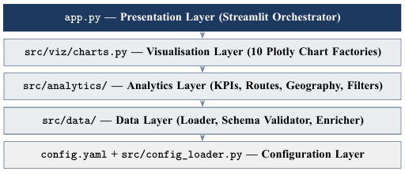
Model Architecture
Dept of CSE (AI & ML), SOE-Dayananda Sagar University

Slide 8
EXPERIMENTATION
Experimental Design: Describe the methodology and approach used for conducting experiments. This could involve detailing variables, control groups, experimental groups, and any specific procedures or protocols followed.
Data Collection Methods: Explain how data was collected during the experiments. This might involve surveys, interviews, observations, or other techniques. Include details about any tools or instruments used for data collection.
Etc
Dept of CSE (AI & ML), SOE-Dayananda Sagar University

Slide 9
RESULTS
Snapshots and brief information of the Results achieved through the project
Dept of CSE (AI & ML), SOE-Dayananda Sagar University

